Slide 1
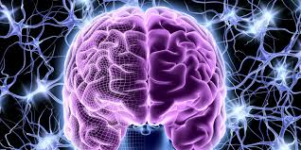
ONE MIND
TWO HEMISPHERES

Slide 2
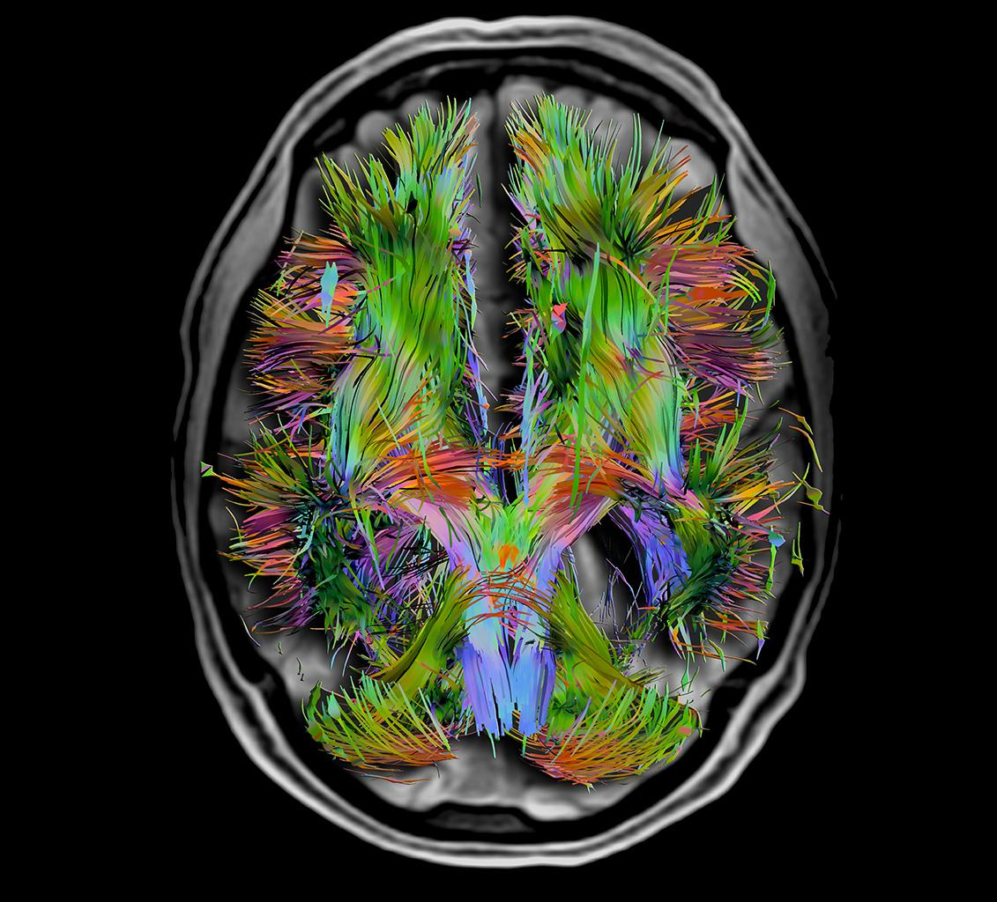
CAN WE TRULY ESTABLISH AN INTERCONNECTED NETWORK THAT SUPPORTS COLLABORATION OVER COMPETITION ?

Slide 3
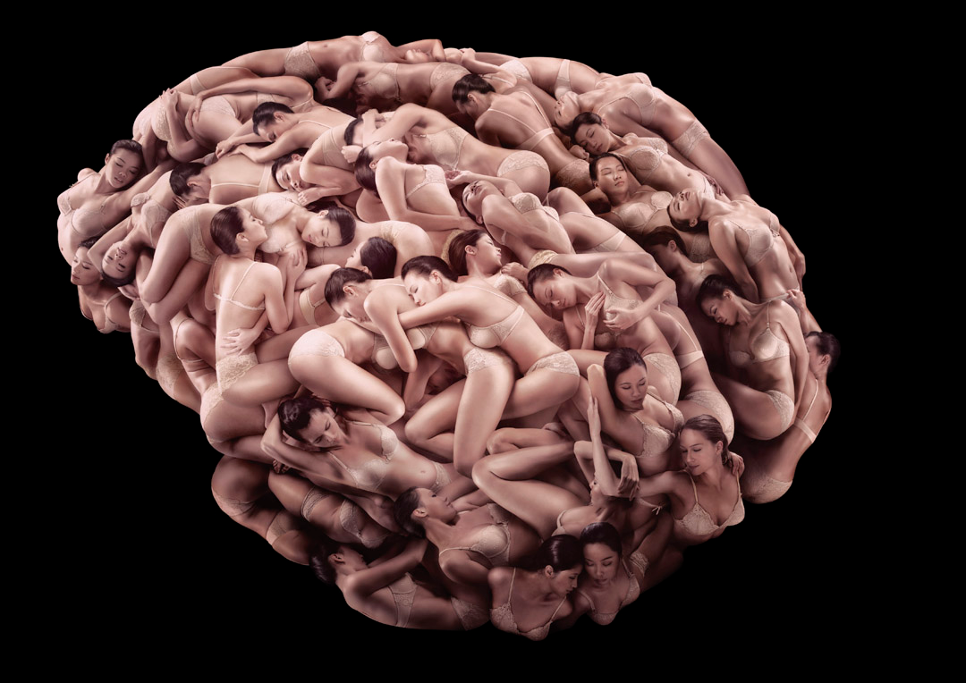
FACTS VERSUS FICTION

Slide 4
EVIDENCE FOR A MODEL OF COLLABORATION IN TBI
Historically , the Field of TBI Research Has Been a Model of Collaboration Particularly in Comparison to Other Neurological Disorders
Both the NNTS and INTS Societies Have Supported and Encouraged Young as well as New Investigators and Their Collaboration Through the Provision of Large Numbers of Travel Grants and Society Prizes and Purses
A History of Collaboration Has Been Particularly Impressive in the Clinical Arena Due the Fundamental Need for the Accrual of Large Numbers of Patients
The Field’s Journals, in Particular the Journal of Neurotrauma, Have Supported Collaboration Via the Publication of Large Numbers of Clinical and Basic Science Conference and Consensus Reports as well as Large, Multi-Authored Clinical Investigations.
Some Funding Agencies, Particularly the DoD, Have Supported Large Multi-Center, Preclinical Studies- Operation Brain Trauma Therapy.

Slide 5


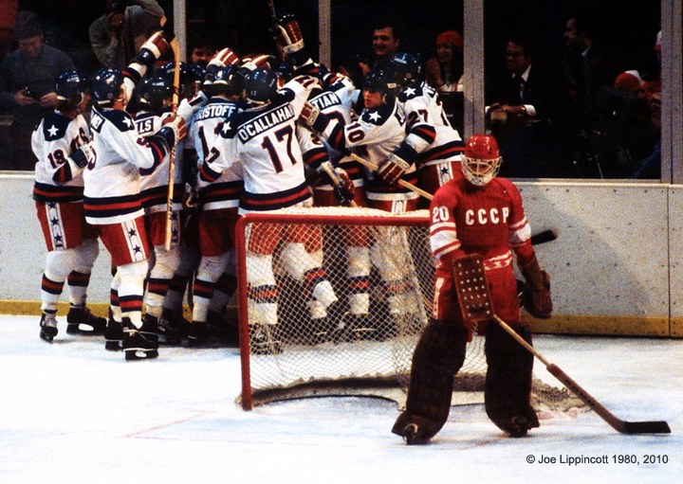
The Thrill of Victory & the Agony of Defeat
Patrick M. Kochanek, MD, MCCM, Helen Bramlett, PhD, C. Edward Dixon, PhD,
Deborah A. Shear, PhD, Stefania Mondello, MD, MPH, PhD, W. Dalton Dietrich, PhD,
MAJ Kara Schmid, PhD, Ronald L. Hayes, PhD, Kevin K. Wang, PhD, Michael Catania, PhD, Olena Glushakova, MS, John Anagli, PhD, Audrey Lafrenaye, PhD, John T. Povlishock, PhD, and Frank C. Tortella, PhD

Slide 6

We know a lot a about secondary injury mechanisms in TBI
SEVERE TBI
Classical View
Calpain
AXONAL
DENDRITIC& SYNAPTIC
INJURY
ISCHEMIA &
CBF-METABOLISM
MIS-MATCH
DIRECT PARENCHYMAL &
VASCULAR DISRUPTION
AND DEPOLORIZATION
Excitotoxicity
Spreading depression
Oxidative
Stress
K⁺ EAA Ca++
O₂⁻ ONOO –
AA GSK3β PKC
Seizures
Proteolysis
BBB
CONTUSION
VASCULAR
DYSREGULATION
Mitochondrial
Failure
ER
Stress
SUR-1
VASOGENIC
EDEMA
TISSUE
OSMOLAR
LOAD
HEMATOMA
Cell
Death
HMGB-1 TLR-4
ASTROCYTE
SWELLING
AQP-4
CBV
Autophagy
ICP
APOPTOSIS
INFLAMMATION
NECROSIS
Necroptosis
Pyroptosis

Slide 7

Therapies to consider ?
Low hanging fruit—FDA approved for other uses
Progesterone
Cyclosporine-A
Simvastatin
Atorvistatin
FK-506
Minocycline
Rolipram
Nicotinamide
Erythropoietin
Pentostatin
Glibenclamide
Lithium
NAC
Amantadine
Pioglitazone
Levetiracetam
Hypothermia
Kollidon VA 64
To begin we specifically targeted
low hanging fruit
Therapies with
1) Strong literature support for in preclinical TBI studies from multiple labs
or
2) A suggestion of efficacy based on sporadic clinical use and thus could be rapidly taken to an RCT

Slide 8
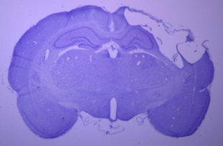
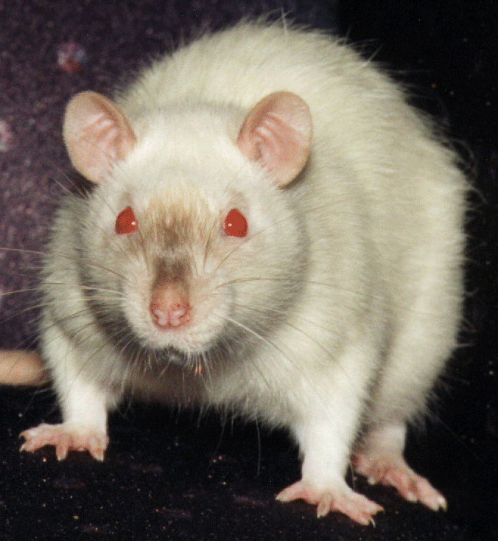
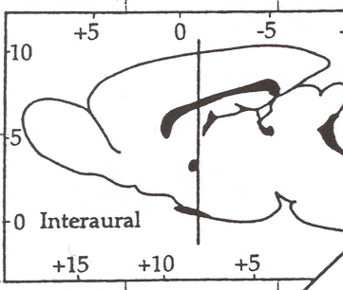
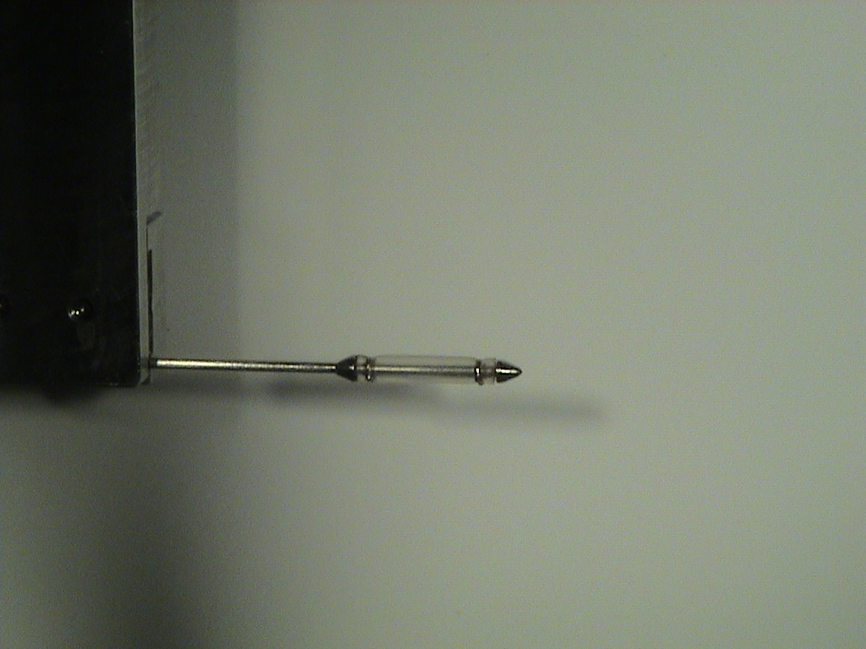
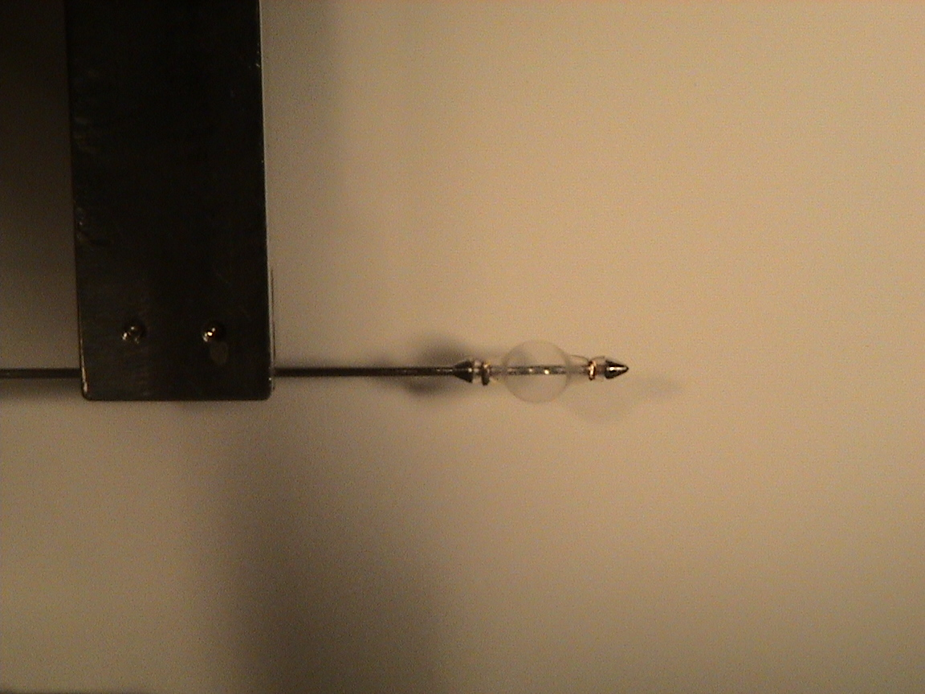
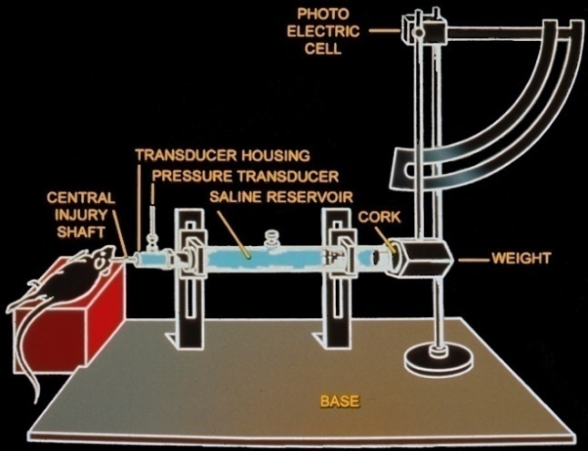
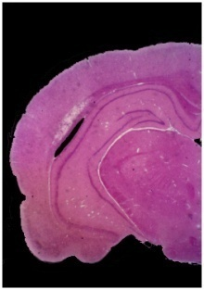
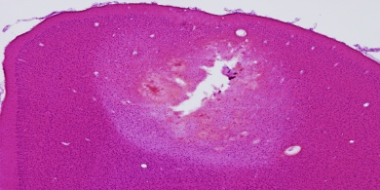

Experimental TBI models for primary therapeutic screening in OBTT
Controlled Cortical Impact (CCI)
(University of Pittsburgh site)
C. Edward Dixon, PhD
Penetrating Ballistic-Like Brain Injury (PBBI)
(WRAIR)
F. Tortella, PhD
Deborah Shear, PhD
MAJ Kara Schmid, PhD
Dixon et al, J Neurosci Methods, 1991
Parasagittal Fluid Percussion Injury (FPI)
(Miami Project site)
W.D. Dietrich, PhD, Helen Bramlett, PhD)
Three VERY different lesions
Williams et al, J Neurotrauma, 2005
Utagawa, Dietrich, & Bramlett, Exp Neurol, 2008

Slide 9
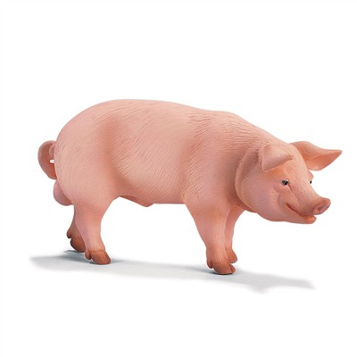
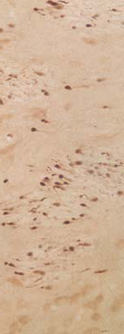
Second Tier Drug Screening of the most promising therapies
Axonal injury , GFAP, IBA-1 and vascular endpoints
FPI in Micropig
(VCU)
J. Povlishock, PhD

Slide 10
IMPEDIMENTS TO SUCCESSFUL COLLABORATION IN TBI DISCOVERY
A Societal Culture That Values Individual Discovery
An NIH Funding Culture That Favors Individual Research Discovery-RO1 Driven Research
An NIH RO1 Funding Culture That Emphasizes Innovation and Impact Which Are Not Necessarily Major Components of Collaborative Research
A Recent Trend in State-Supported Universities and a Long-Standing Practice in Private Universities That Faculty Must Generate Significant Portions of Their Salary from Granting Agencies, with the NIH Being the Dominant Player in This Area of Support
The Recent Trend in Both Public and Private Institutions That Even the Award of Tenure Does Not Come With Complete Financial Support, Again With the Caveat That the Tenured Faculty Member Must Support Significant Portions of HIS/Her Salary Via Extramural Funding
The Net Result of All the Above Defaults to Competition Rather Than Collaboration

Slide 11
CAN THESE BARRIERS TO ROUTINE COLLABORATION IN TBI BE RESOLVED?
Removal of Some Barriers to Collaboration Will Require a Change in Culture At Both the University and Federal Funding Level
Successful Collaboration Will Require Some Refinement of Federal Agency Funding Practices To Support Major Collaboration That Is Not Necessarily Discovery Based. This Is Particularly So in Basic Science and Preclinical Investigations .
Successful Collaboration Will Also Require Some Realignment of University Tenure and Promotion Processes To Include More Recognition of Collaborative Efforts.
Successful Collaboration Will Also Be Best Served by a More Rational Underpinning of University Faculty Salaries That Is Not So Highly Leveraged to Federal/Foundation Funding.

Slide 12
